Slide 1
BANK LOAN DEFAULT
21-01-2020

Slide 2
SUMMARY
A Bank accepts deposits from customers and from the corpus thus available, it lends to Borrowers who want to carry out certain Business activities for Growth and Profit. It is often seen that due to some reasons like failure of Business, the company making losses or the company becoming delinquent/bankrupt the loans are either not Paid in full or are Charged-off or are written off. The Bank is thus faced with the problem of identifying those Borrowers who can pay up in full and not lending to borrowers who are likely to default.
At the time of giving loan to a new customer or a company, the bank needs to know the chance of getting risk on loan repayment, based on some relevant information.
Predicting the chance of risk is more relevant before giving the loan. So, it reduces the risk of profit & loss of the bank.
When the prediction is showing high risk, the bank have to collect more information about the background of that particular company. Then bank will decide to give the loan or not.

Slide 3
BUSINESS PROBLEM
The objective of the analysis is to predict whether the customer will fall under loan default or not.

Slide 4
PROJECT ARCHITECTURE
RAW DATA COLLECTED
DATA PROCESSING
CLEAN DATASET
EXPLORATORY DATA ANALYSIS
MODELS BUILDING
MODEL SELECTION
DEPLOYMENT

Slide 5
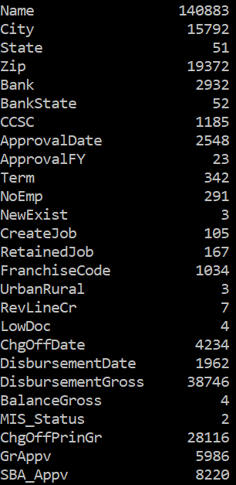
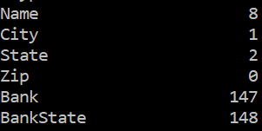
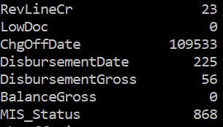
DATA Cleaning
KNN imputation
Median imputation
DATA SET unique value count NULL VALUES

Slide 6
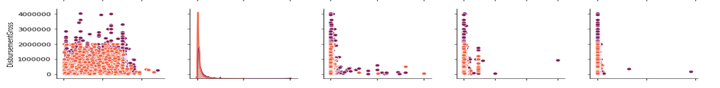

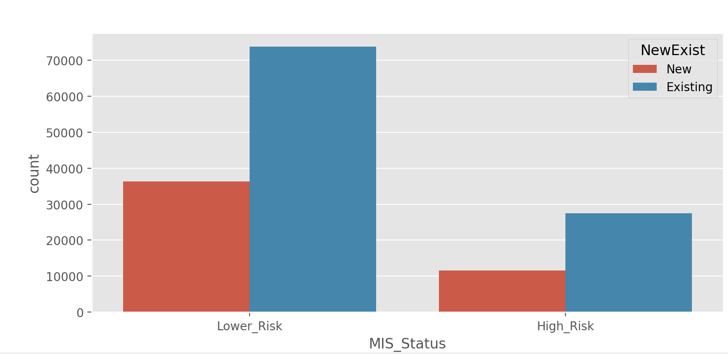
EDA
As per the graph for Disbursement Gross,more cases have less amount as the disbursement gross amount increases, chances of defaulting decreases.
Existing businesses have a marginally more chance to default than new businesses.

Slide 7
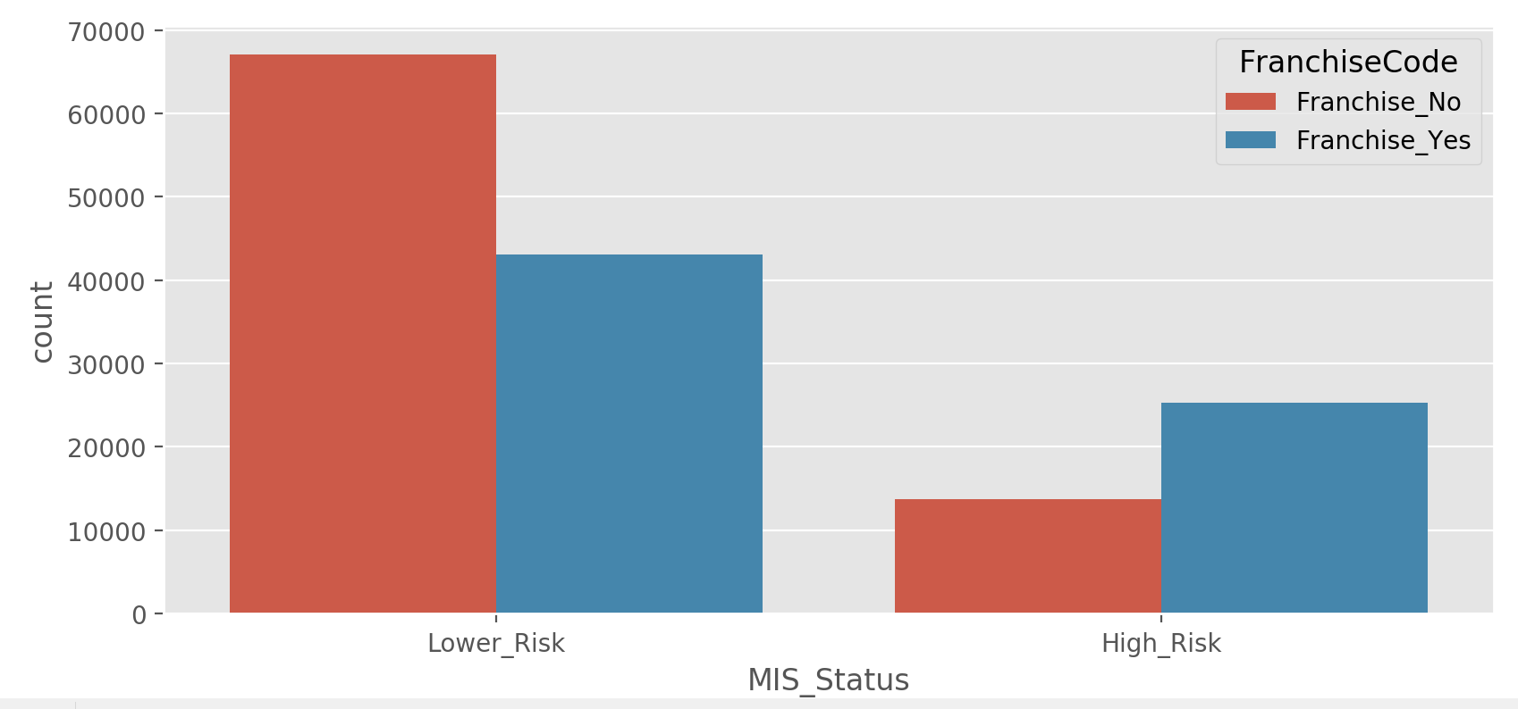
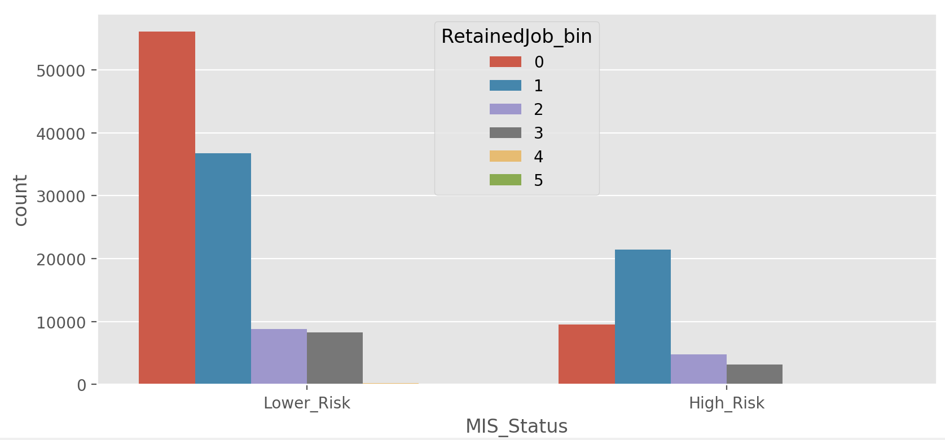
5260 businesses have franchises and defaulting chances are less for businesses with franchises.
If no jobs retained, defaulting is very less, then the chances of defaulting comes down as the jobs increases.

Slide 8
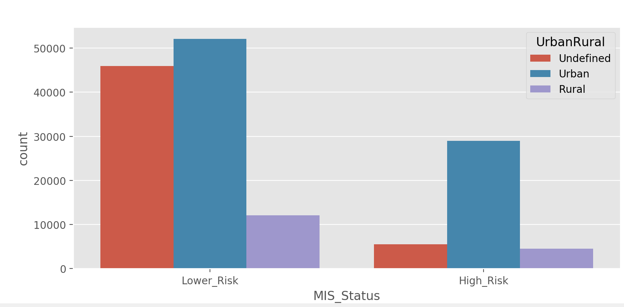
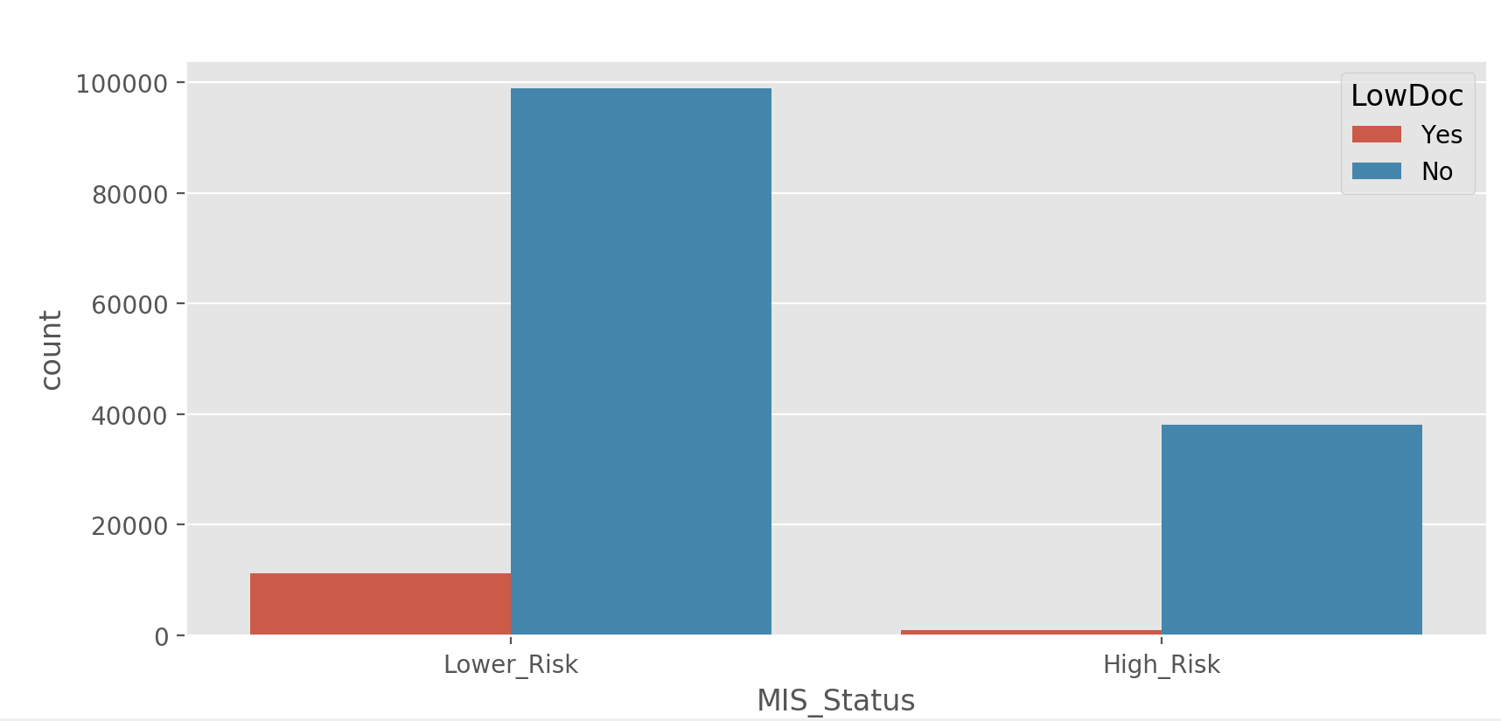
Urban business more likely to default than rural businesses
If covered under LowDoc, then very unlikely to default.

Slide 9
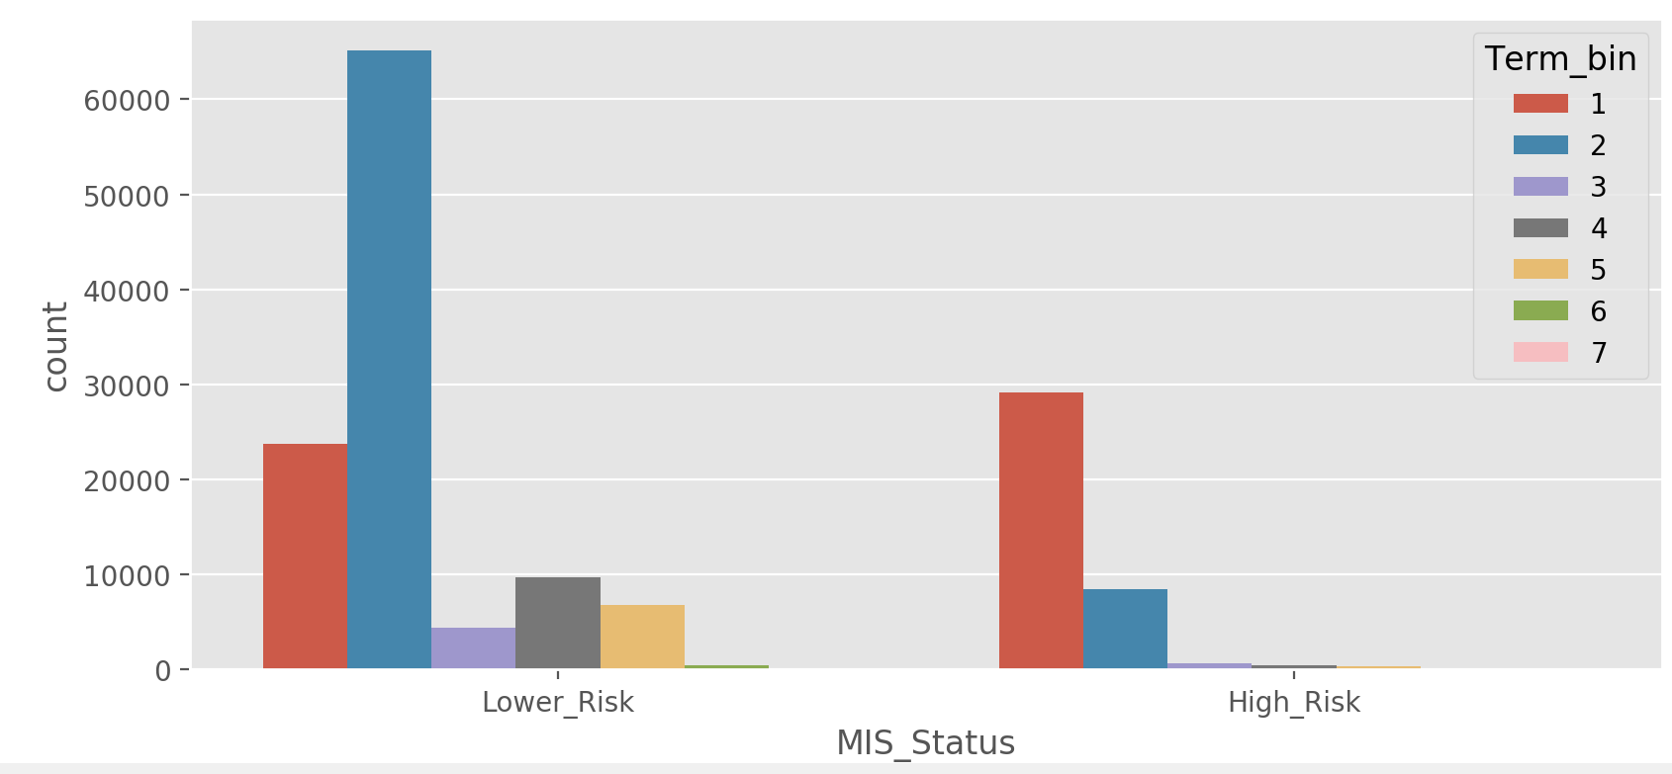
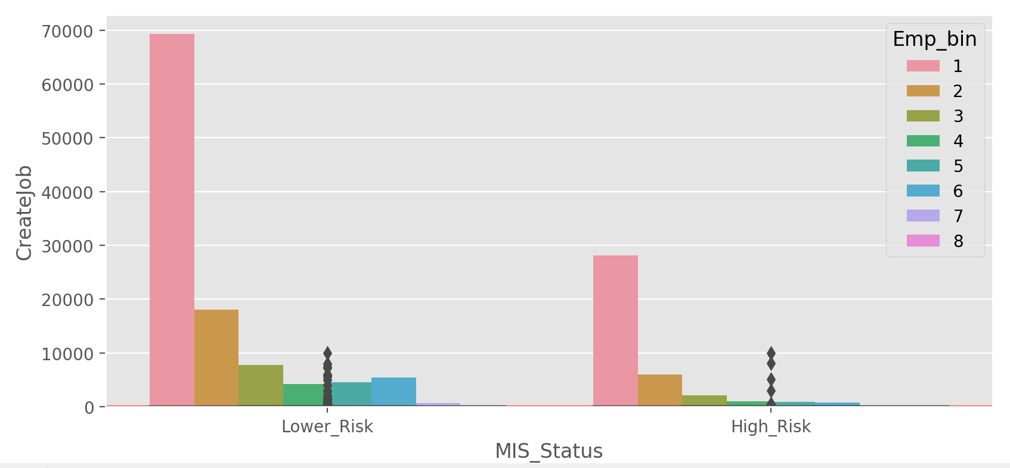
Loans for 0-5 and 30-40 month term has more chance of defaulting, and 5-30 month term less chance of defaulting.
As the number of employees in the business increase, chances of defaulting decreases.

Slide 10
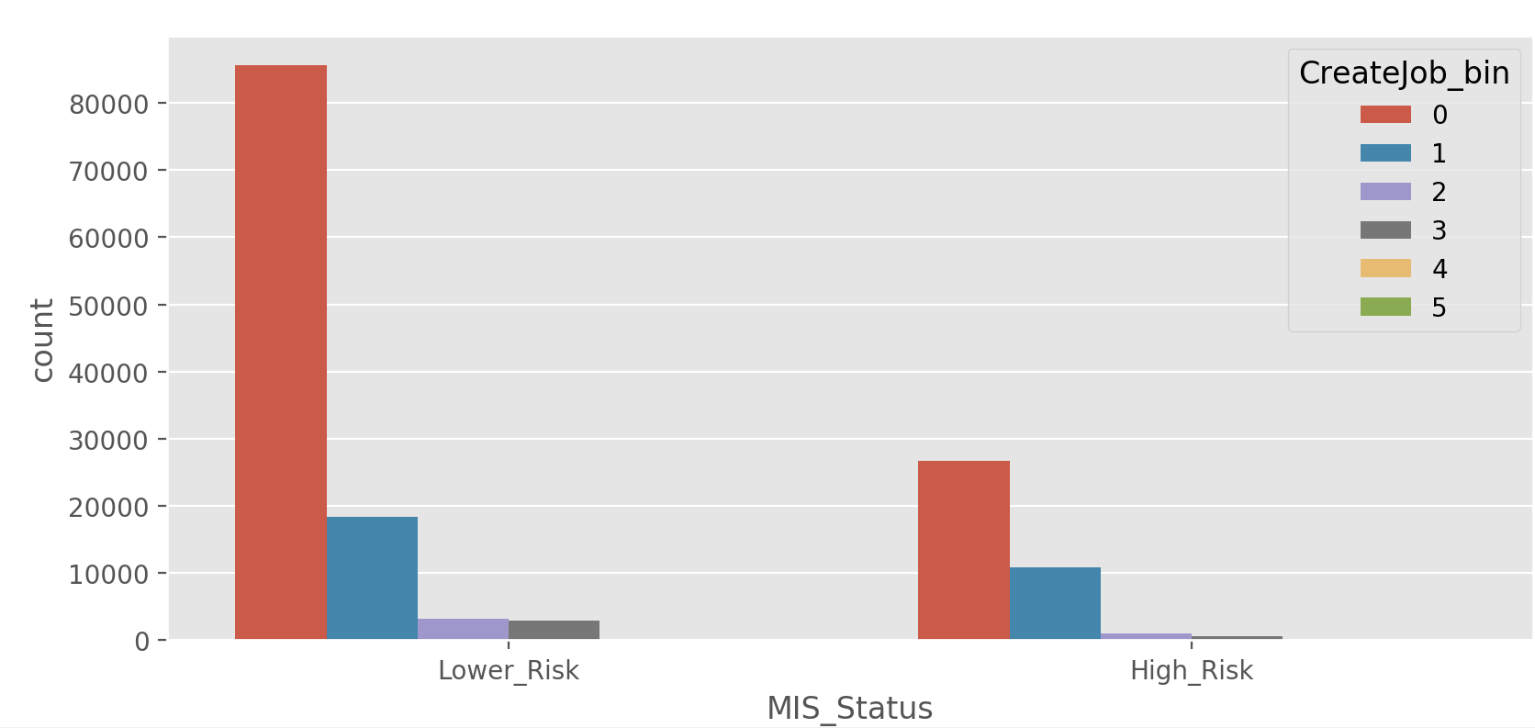
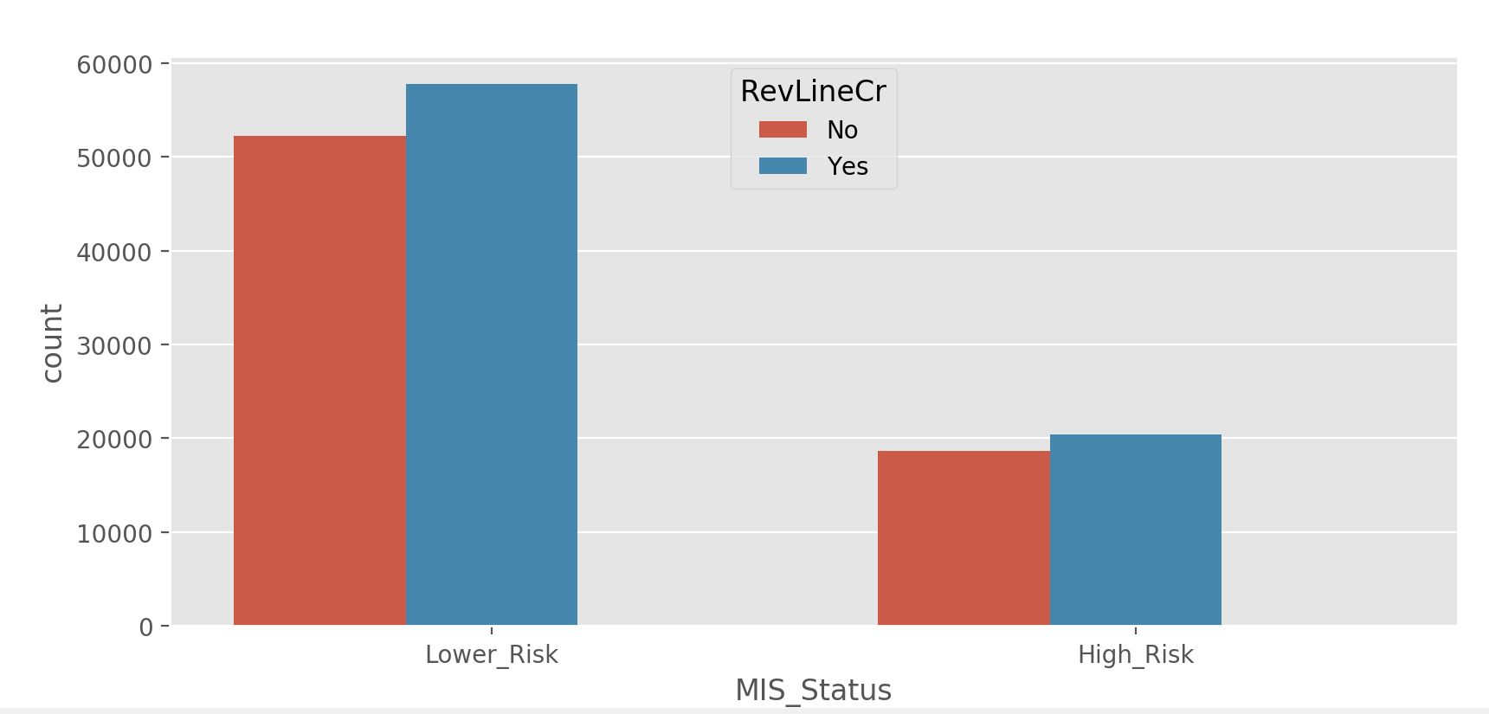
Chances of defaulting is least when jobs created is between 10 and 400, highest when greater than 400.
For revolving line of credit the chances of default is less than non revolving line

Slide 11
when comparing with SBA_Appv, GrAppv and DisbursementGross variables, Disbursement gross variable is more informative. Why because, at the time of a customer reaches to the bank for loan request, the bank have no information about the SBA_Appv. So bank is considering that only the requested amount of that customer for risk prediction.
So dropping GrAppv and SBA_Appv from data for solving multicollinearity problem and it also fixed the duplication problem.
Dropping chargeoffprin column as this amount will not present when a customer ask for a loan to the bank

Slide 12
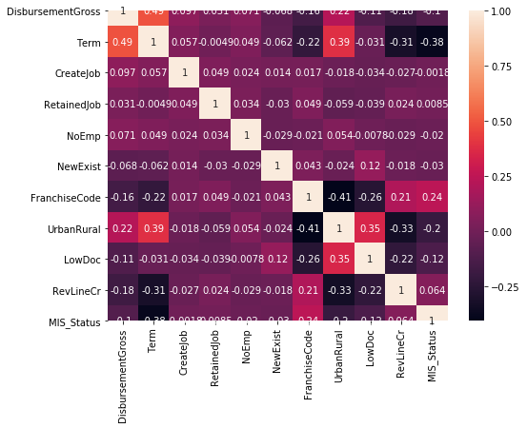
Heatmap of correlation matrix after removing the GrAppv and SBA_apprv and chargeoffprin: multi collenearity problem solved.

Slide 13
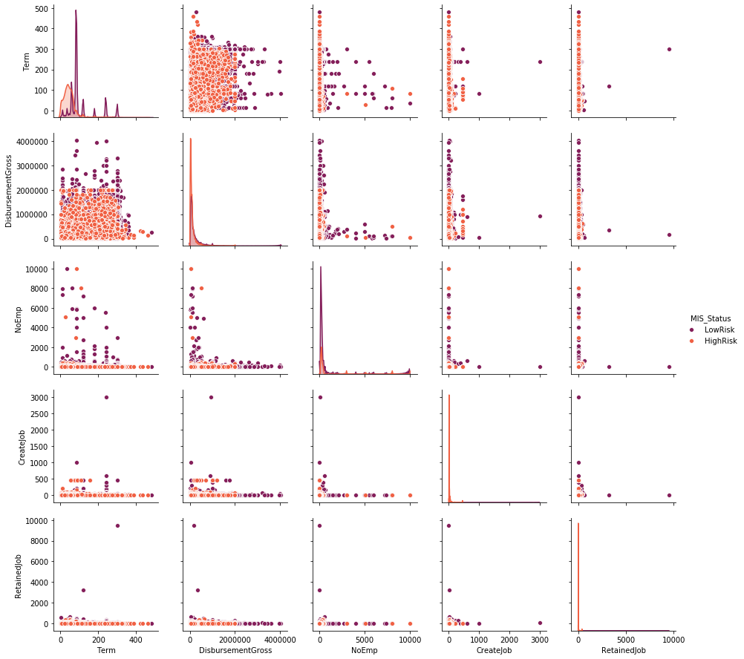
Pairplot : For finding overlapping of dependent variable and relation between variables.

Slide 14
Summary statistics of numerical Variables: Measuring Distribution of the data.
 | count | mean | std | min | 25% | 50% | 75% | max
Term | 149118.0 | 93.202772 | 69.375185 | 1.0 | 58.0 | 84.0 | 84.0 | 480.0
DisbursementGross | 149118.0 | 142115.994414 | 218960.686316 | 4000.0 | 30000.0 | 66600.0 | 150000.0 | 4029520.0
NoEmp | 149118.0 | 9.292285 | 76.956490 | 0.0 | 2.0 | 4.0 | 8.0 | 9999.0
CreateJob | 149118.0 | 1.281006 | 10.980435 | 0.0 | 0.0 | 0.0 | 0.0 | 3000.0
RetainedJob | 149118.0 | 3.686892 | 27.756936 | 0.0 | 0.0 | 1.0 | 4.0 | 9500.0
Variables are Positively skewed .
In Variable CreateJob, 75% of the data is lies between zero. So we have to check the importance of that variable with the output.
RetainedJob variable is highly affected by outlier problem. Because, the 74% is 4 and maximum is 9500 is too large.

Slide 15
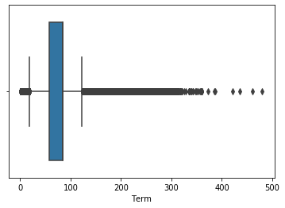
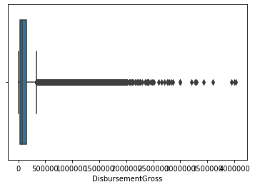
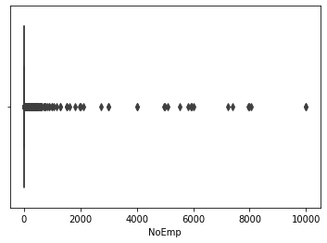
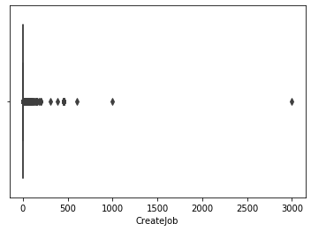
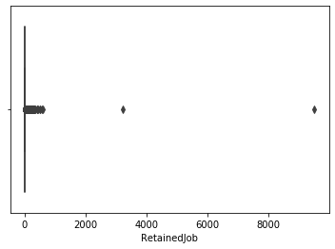
Box Plot (For visualisation of outliers):

Slide 16
Based on the box plot, CreateJob and RetainedJob are influenced by outliers compare with NoEmp variable.
considering that, here we have no use of these three variables, so total number of Employees have high priority for model prediction.

Slide 17
Model Building
Variables Taken for Model Building:
DisbursementGross
Term
NoEmp
NewExist
FranchiseCode
UrbanRural
LowDoc
RevLineCr
MIS_Status (Output Variable)

Slide 18
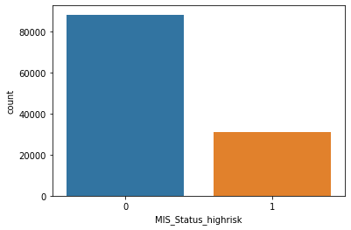
Count Plot of Output Variable: Visualisation of Imbalance of Train Data.
After train-test ,the output data is imbalance in train data.So, before model building we have to treat the imbalance of the train data set. Using over Sampling technique called SMOTE.

Slide 19
Models Created after SMOTE and Standard Scalar(with standardization)
The distance measuring machine learning algorithms need standardization because these independent variables are in different scale. So, we are fixing the scaling issue with standardization technique.
The below models have been completed after standardization :
Logistic Regression
KNN
SVM
Naive Bayes
Models completed without Standardization
Decision Tree
Random Forest
XGB

Slide 20
Selected Model: XGB classifier with parameter tuning
XGBClassifier(base_score=0.5, booster='gbtree', colsample_bylevel=1, colsample_bynode=1,
colsample_bytree=1, gamma=0, gpu_id=-1, importance_type='gain', interaction_constraints='',
learning_rate=0.300000012, max_delta_step=0, max_depth=6, min_child_weight=5, missing=nan, monotone_constraints='()', n_estimators=109, n_jobs=0, num_parallel_tree=1,
random_state=0, reg_alpha=0, reg_lambda=1,scale_pos_weight=2,subsample=1,
tree_method='exact', validate_parameters=1, verbosity=None)

Slide 21
Result :
confusion_matrix of train data is : [[82384 5786]
[ 2285 85885]]
Gradient Boosting Model Accuracy in train dataset is : 0.954
confusion_matrix of test data is : [[20391 1549]
[ 498 7386]]
Gradient Boosting Model Accuracy in test dataset is : 0.931
Based on the following confusion matrix of model, the accuracy of correct prediction of low risk is = (20391)/(20391+1549) *100 = 92.939%
Correct prediction of high risk is = (7386)/(7386+498) *100 = 93.68 %
So, selecting this Model for deployment.

Slide 22
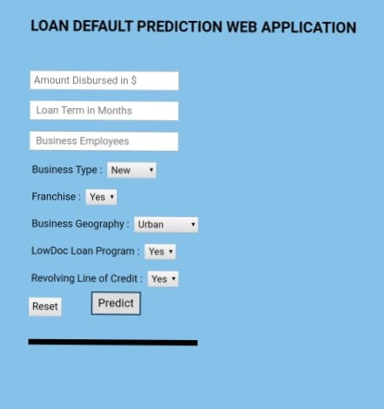
Deployment Steps:
templates/index.html
static/style.css
app.py
Procfile
requirements.txt
Attach files with Github
Heroku web app deployment.
Final heroku app page:
http://customer-default-prediction.herokuapp.com/

